Slide 1
Flipping to Open Access: The C&RL Story
David Free
Editor-in-Chief, C&RL News

Slide 2
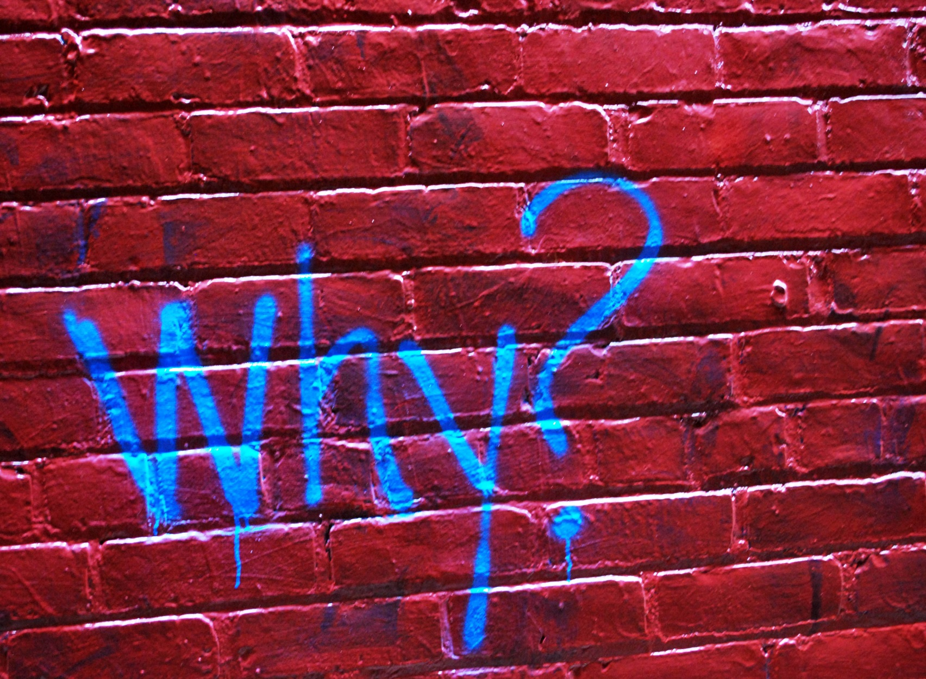

Slide 3
Librarians accelerate the transition to more open and equitable systems of scholarship.
- ACRL Plan for Excellence

Slide 4
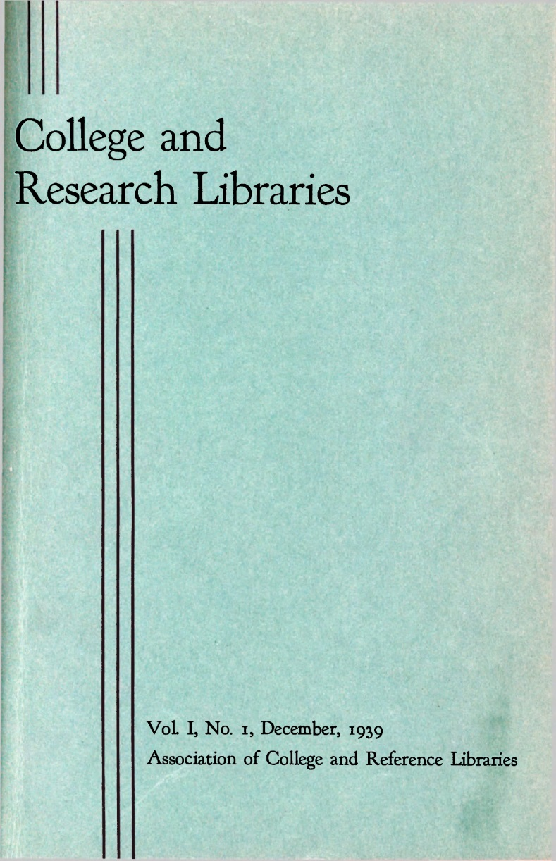

Slide 5
Advertising
+
Subscriptions

Slide 7
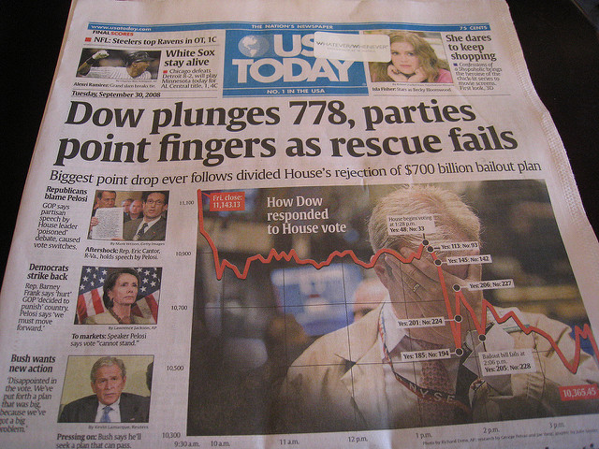

Slide 8
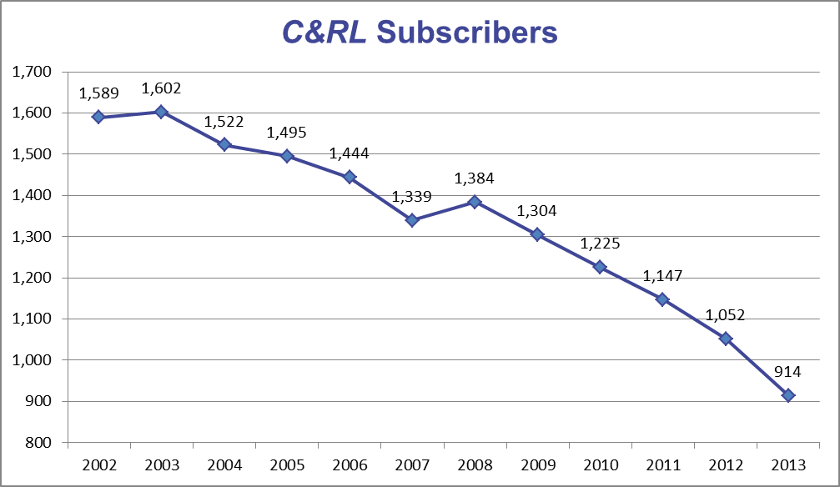

Slide 9
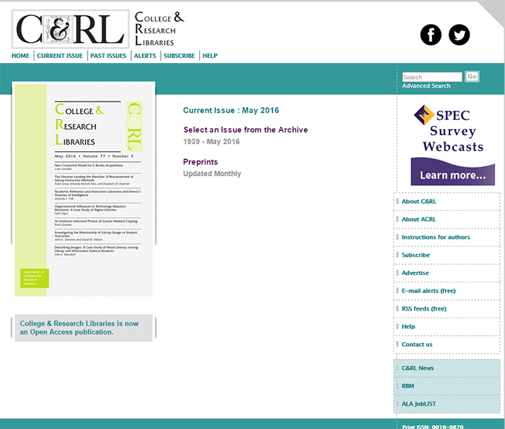

Slide 10
Advertising
+
Association Support
+
Community Engagement

Slide 11
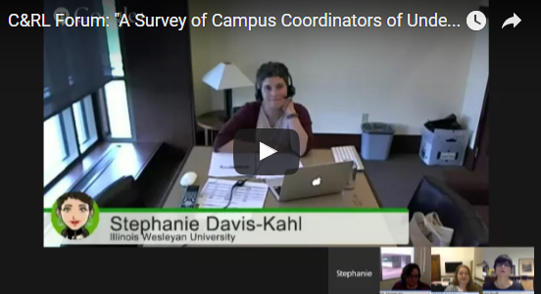

Slide 12
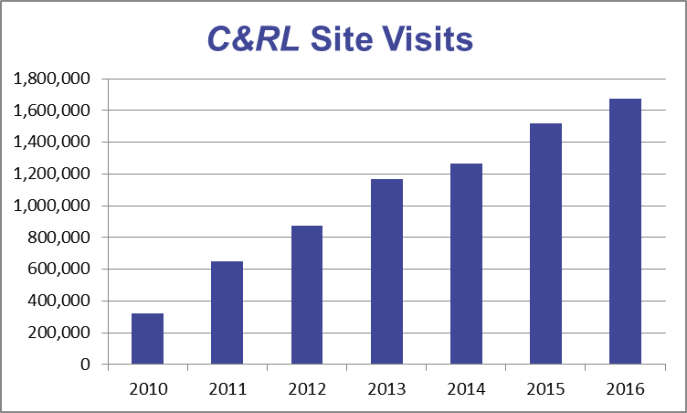

Slide 13
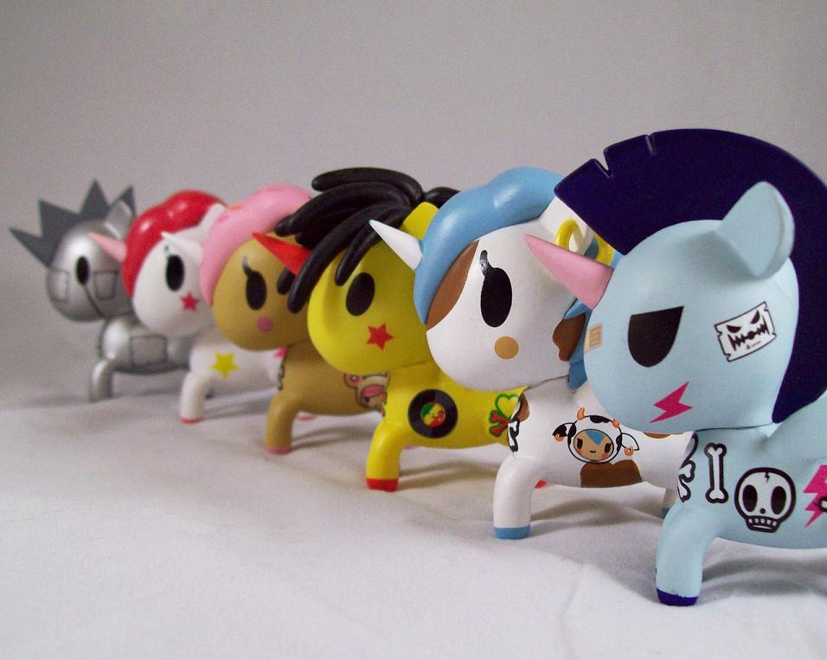

Slide 15
Attribution
Slide 2: Why by Katie Sayer– CC BY-SA 2.0 (https://flic.kr/p/9yaos5)
Slide 7: Recessie 2008 / 2009 by Thomas van de Weerd – CC By 2.0 (https://flic.kr/p/5rgzM4)
Slide 13: Unicorno Army! by Charles Rodstrom – CC BY-NC-ND 2.0 (https://flic.kr/p/di31yw)
Slide 14: value and action by Outi-Maaria Palo-oja – CC BY 2.0 (https://flic.kr/p/zyE9st)

